Slide 1
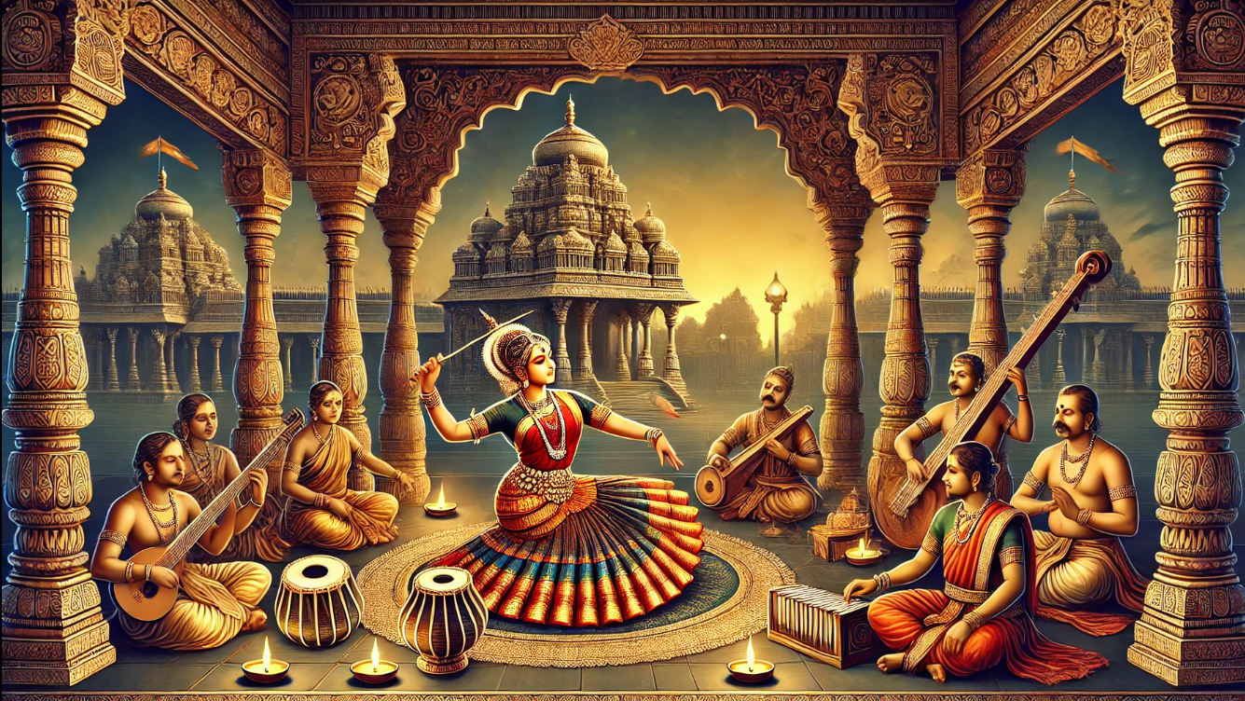
MUSIC AND DANCE FORMS IN INDIA
Exploring Ancient roots, TECHNIQUES AND GLOBAL RELEVANCE

Slide 2
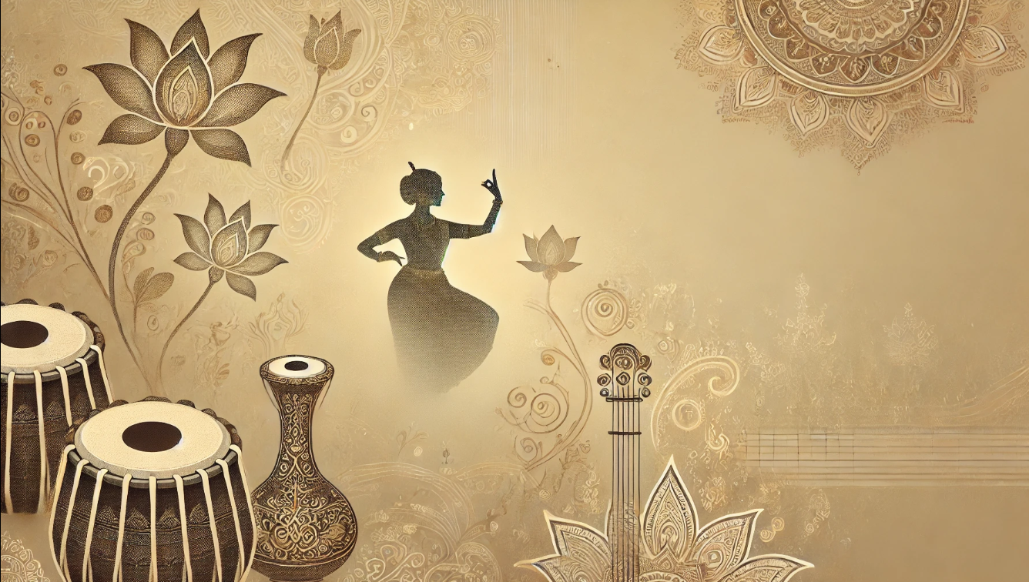




INTRODUCTION
CULTURAL SIGNIFICANCE
SPIRITUAL ESSENCE
Indian music and dance are vital to religious rituals, festivals, and storytelling, reflecting the nation's rich heritage.
These art forms often have a deep spiritual connection, used for devotion and meditation.
TIMELESS EVOLUTION
REGIONAL DIVERSITY
While rooted in tradition, Indian music and dance have adapted to modern influences, maintaining their global appeal
Dance and music provide opportunities for social interaction and cultural exchange, bringing people from diverse backgrounds together in shared creative pursuits..

Slide 3
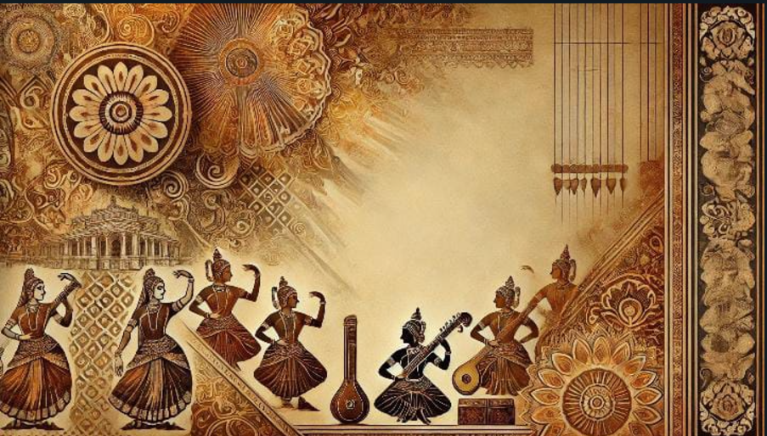

TIMELINE
music
MODERN ERA
With India's independence in 1947, film music became the dominant genre. The 1990s saw the rise of independent music, especially through platforms like YouTube and streaming services
1947- present
Classical period
By the time of the "Natya Shastra" , classical music had begun to evolve, with the "raga" and "tala" systems becoming more structured.
1000 BCE -100 CE
1500 CE-1947
Colonial period
1000 CE -1500 CE
The late 19th and early 20th centuries saw the influence of Western music through the advent of Western instruments, orchestras, and choirs.
Pre 1000 BCE
Ancient era
The earliest form of Indian music can be traced back to the Vedic period.Vedic chants, known as "Samaveda," were the foundation of Indian music.
Medieval period
The arrival of Islamic rule brought new influences, especially from Sufi music, which emphasized devotional poetry and mysticism. Instruments like the sitar, sarod, and tabla gained prominence during this time.

Slide 4
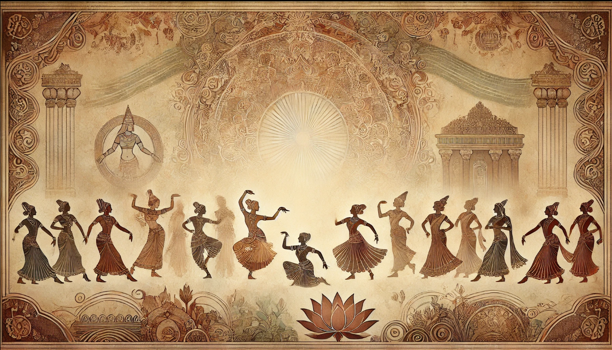
TIMELINE
dance
ANCIENT ERA
Dance in India has ancient roots, with evidence suggesting that it was closely tied to religious rituals, temples, and storytelling in Vedic traditions.
PRE-1000 BCE
CLASSICAL PERIOD
1000 BCE-100 CE
During this period, distinct classical dance forms began to emerge, influenced by religious practices.
1000 CE-1500 CE
MEDIEVAL PERIOD
With the rise of Islamic rule in India, many temple practices and traditional dance forms faced suppression or decline. However new tradition rose.
1500 CE - 1947
COLONIAL PERIOD
British colonial rule had a significant impact on Indian dance, with many traditional forms discouraged.
Revival by artists like Rukmini Devi and Uday Shankar.
1947-PRESENT
MODERN ERA
After India gained independence in 1947, classical dance forms were revitalized and institutionalized through government support along with modern influences.

Slide 5
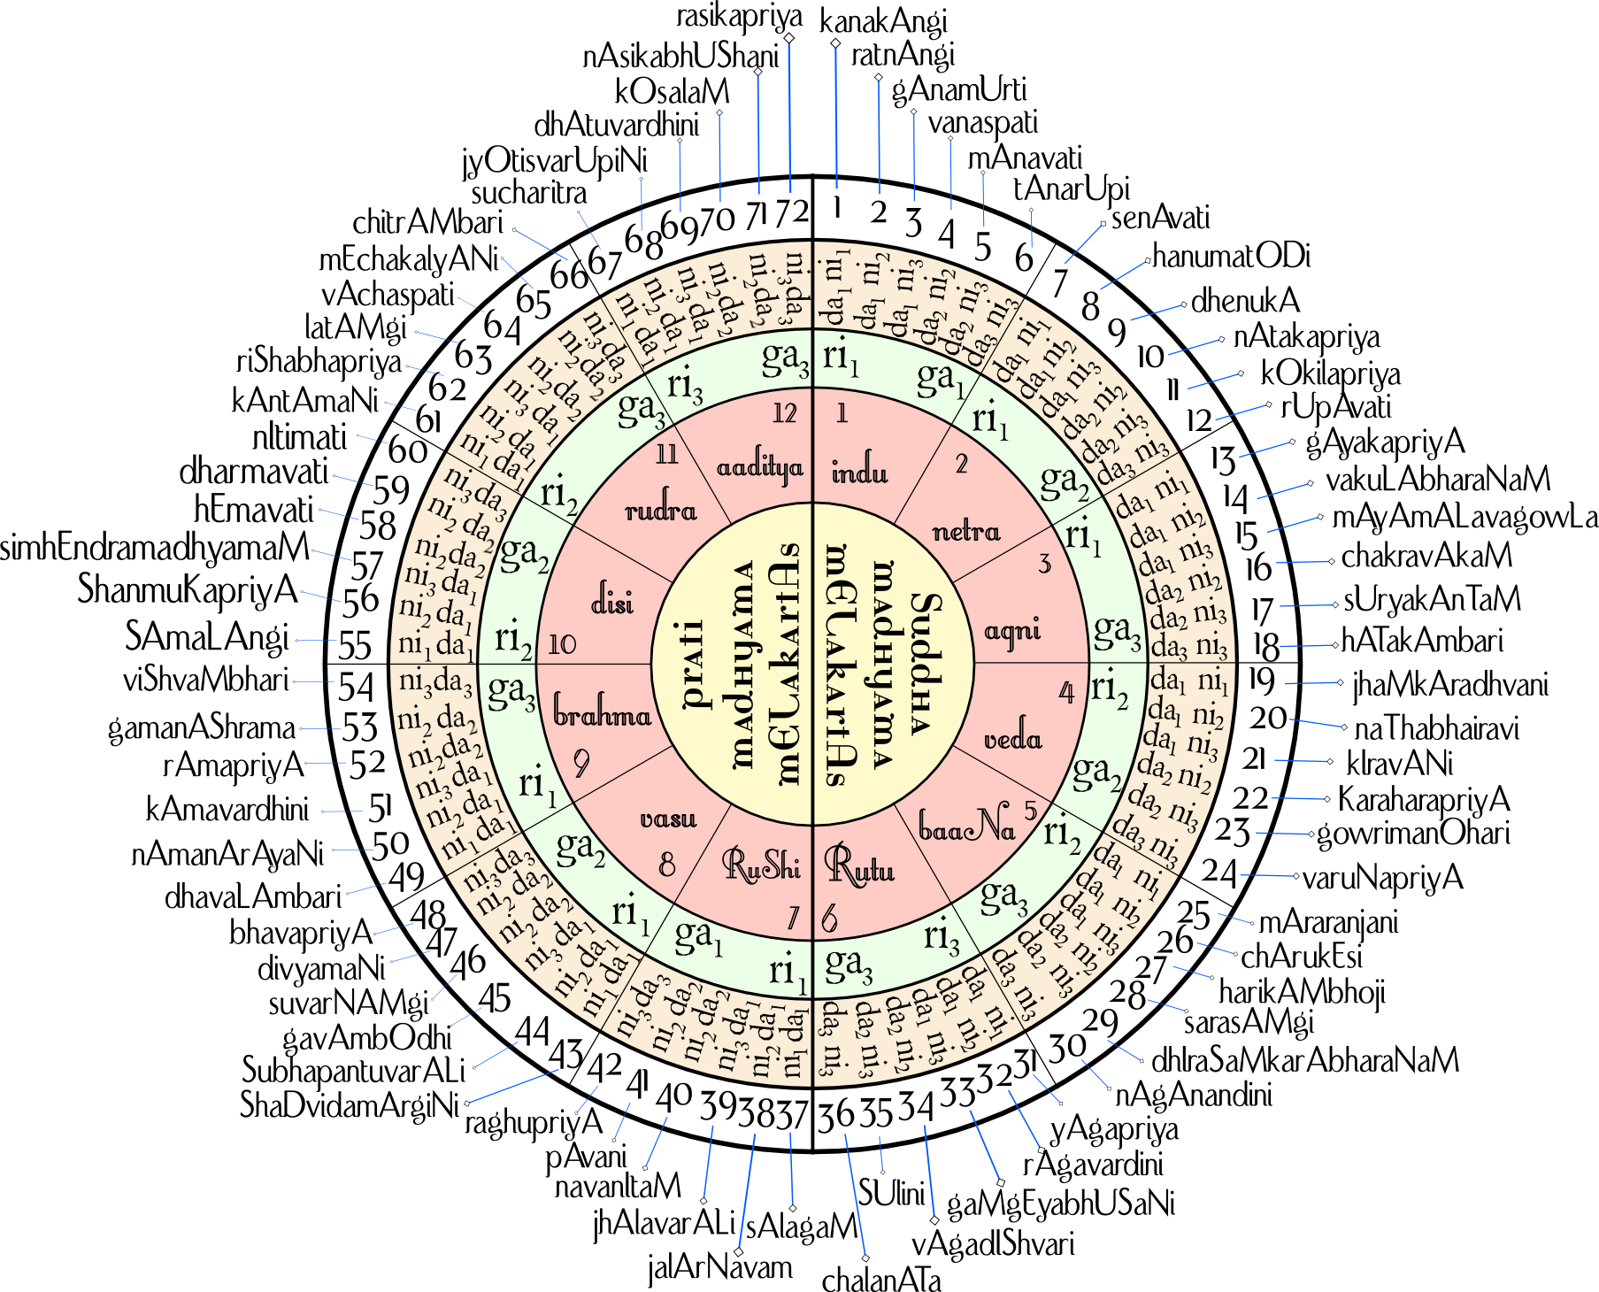
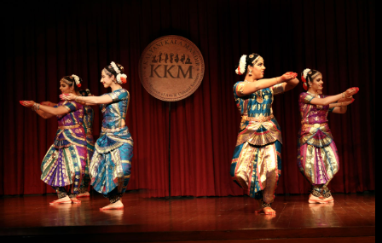
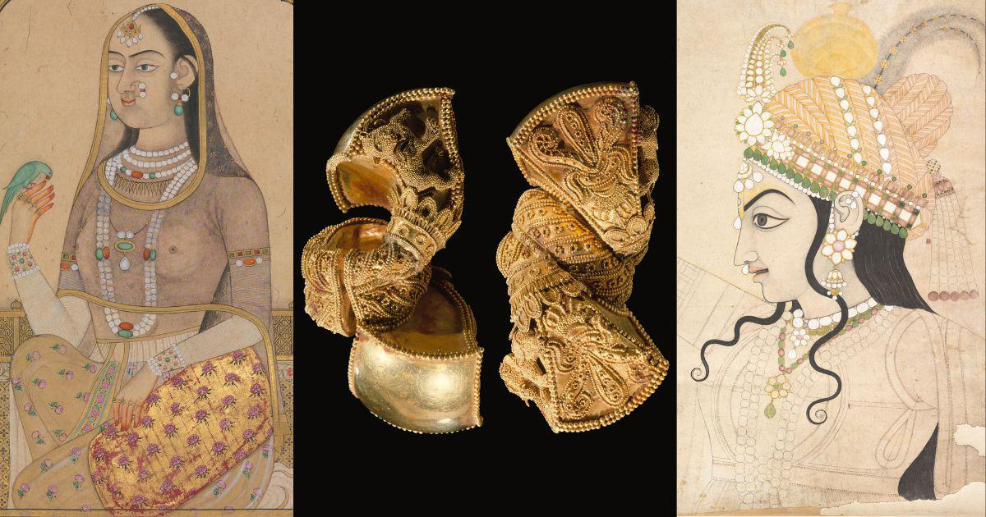
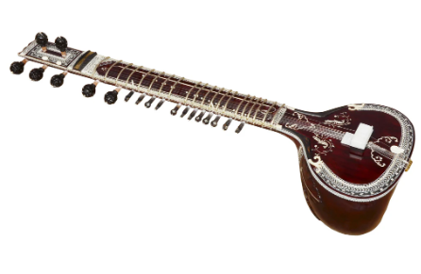
Techniques and Technology Involved

Slide 6






Techniques and Technology Involved
Melodic framework unique to Indian classical music.
Components:Aaroh,Avaroh,Swara,
Time and season.
Types: Hindustani Music & Carnatic
music
RAGA SYSTEM
Symbolic gestures used to narrate stories and emotions.
24 basic mudras described in the Natya Shastra.
Essential in classical dance forms like Bharatanatyam and Kathak
MUDRAS
TALA SYSTEM
ABHINAYA
Rhythmic cycle forming the foundation of Indian music.
Composed of matras arranged in patterns like Teentaal.
Focuses on facial expressions to convey emotions.
Integral in invoking the rasa (emotional essence) in performances.
Enhances the storytelling aspect of dance.
COSTUMES AND JEWELLERY
INSTRUMENTS
Bright, traditional attire designed for specific dance forms.
Jewelry highlights cultural significance (e.g., anklets with bells for rhythm).
Costumes align with characters depicted in performances.
String instruments(vibrations)
Wind instruments(rely on air)
Percussion instruments
(stretched membrane)
4,Solid instruments(strucked instrument)

Slide 7
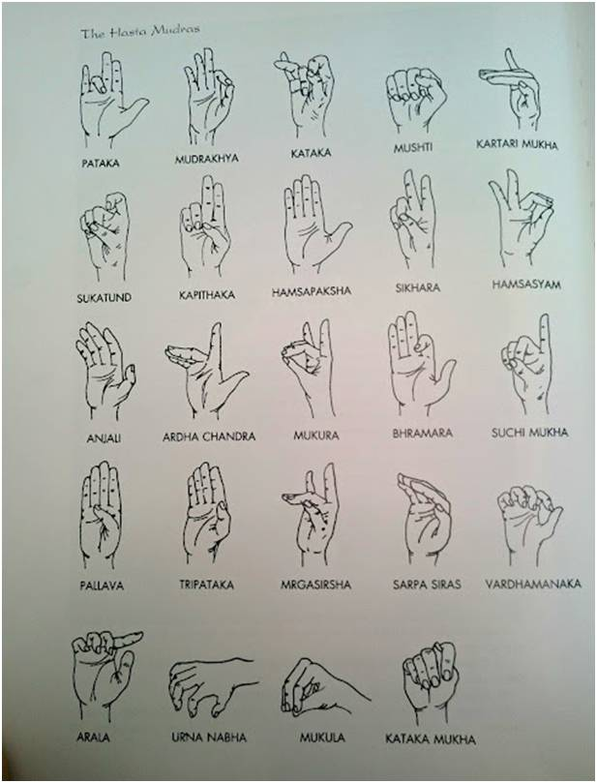

Slide 8
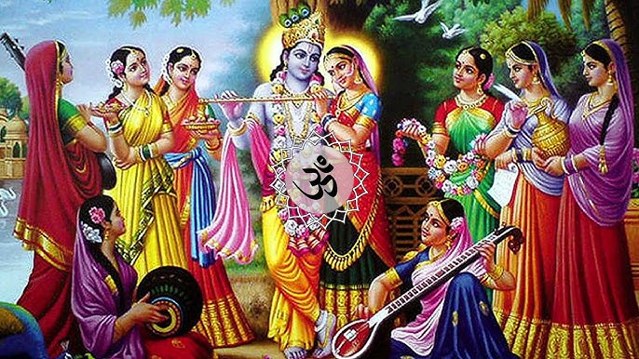
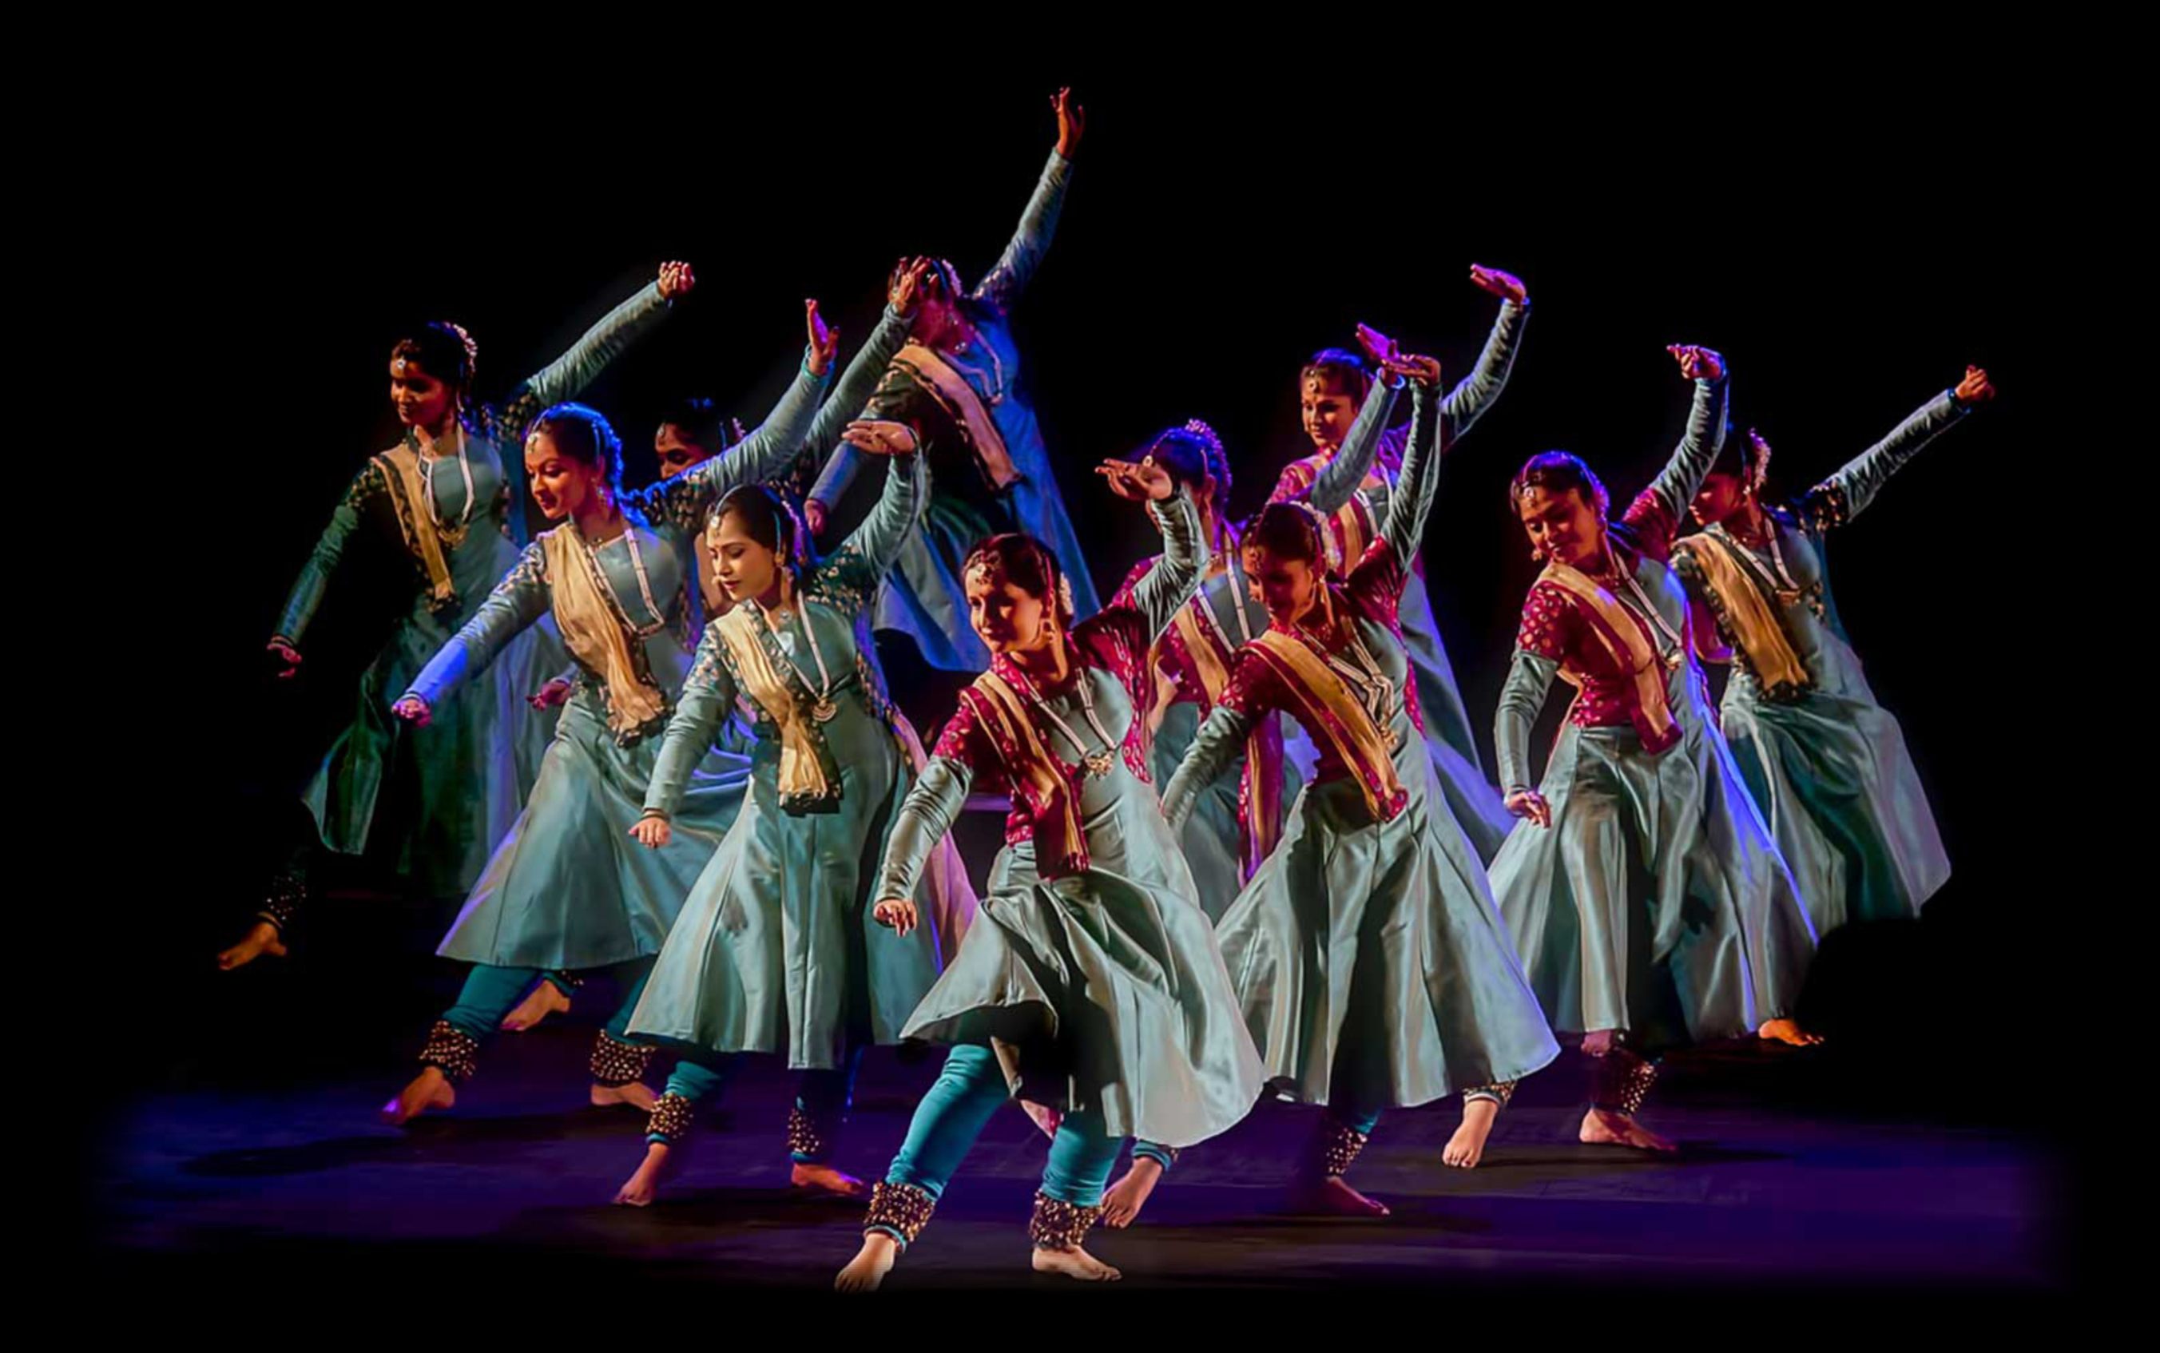
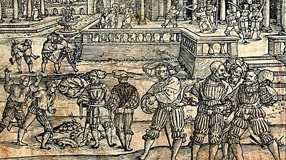
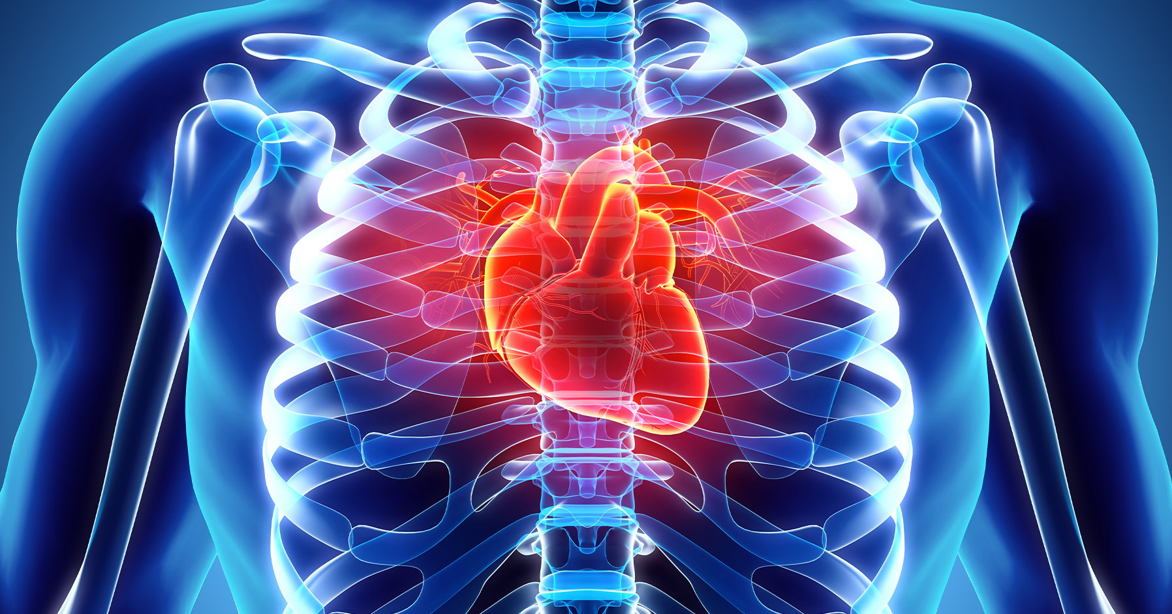
NOTEWORTHY BENEFITS
COORDINTION AND BALANCE
The precision needed in mudras (hand gestures) and rhythmic footwork promotes better hand-eye coordination and balance.
MUSIC AS THERAPY
Indian classical music, through its intricate ragas, has been used for therapeutic purposes to alleviate stress, anxiety, and depression.
The rhythmic cycles and meditative tones enhance mental well-being and create a calming effect.
SPIRITUAL GROWTH
FITNESS AND HEALTH
Both music and dance in India are closely tied to spirituality, with performances often being offerings to deities.
Practices like Bhajans (devotional songs) and temple dances aim to elevate spiritual awareness.
Indian dance forms require rigorous practice, which enhances physical fitness, flexibility, and endurance.
Movements like leaps, bends, and intricate footwork strengthen muscles and improve posture.

Slide 9
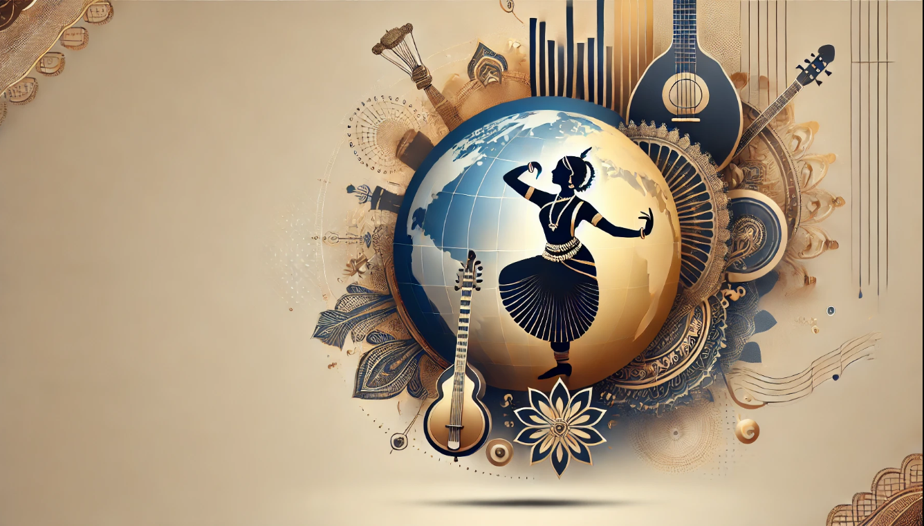






CULTURAL DIPLOMACY
Performances by maestros like Pandit Ravi Shankar and dancers like
Mallika Sarabhai have showcased India’s Heritage on global scale
FUSION WITH GLOBAL MUSIC
Collaboration with Western genres has created appreciation for Indian rythms. Incorporation of instruments like Sitar and Tabla in global music.
PRESENT DAY GLOBAL RELEVANCE
INTERNATIONAL DANCE FESTIVALS
Events like Natya Kala Conference and Indian cultural weeks held in countries like USA UK, and Japan to attract indian dance forms.
EDUCATIONAL OUTREACH
Universities and academies across the world include Indian music and dance in curriculum (example: University of California).
BOLLYWOOD’S INFLUENCE
Dance moves like Kathak are inspired choreography have gained recognition in pop culture blending tradition with contemporary elements.

Slide 10

SUSTAINIBILITY AND ACCESSIBILITY
SOLUTIONS
CHALLENGES
Decline in interest among younger generations.
Limited accessibility for rural and global audiences.
Loss of traditions due to inadequate documentation.
Use digital platforms like YouTube and VR for teaching and promotion.
Provide government grants and subsidies for performers and artisans.
Integrate traditional arts into school curriculums to promote awareness.

Slide 11
SUSTAINIBILITY AND ACCESSIBILITY
SOLUTIONS
CHALLENGES
Decline in interest among younger generations.
Limited accessibility for rural and global audiences.
Loss of traditions due to inadequate documentation.
Use digital platforms like YouTube and VR for teaching and promotion.
Provide government grants and subsidies for performers and artisans.
Integrate traditional arts into school curriculums to promote awareness.

Slide 12
SUSTAINIBILITY AND ACCESSIBILITY
SOLUTIONS
CHALLENGES
Decline in interest among younger generations.
Limited accessibility for rural and global audiences.
Loss of traditions due to inadequate documentation.
Use digital platforms like YouTube and VR for teaching and promotion.
Provide government grants and subsidies for performers and artisans.
Integrate traditional arts into school curriculums to promote awareness.

Slide 13
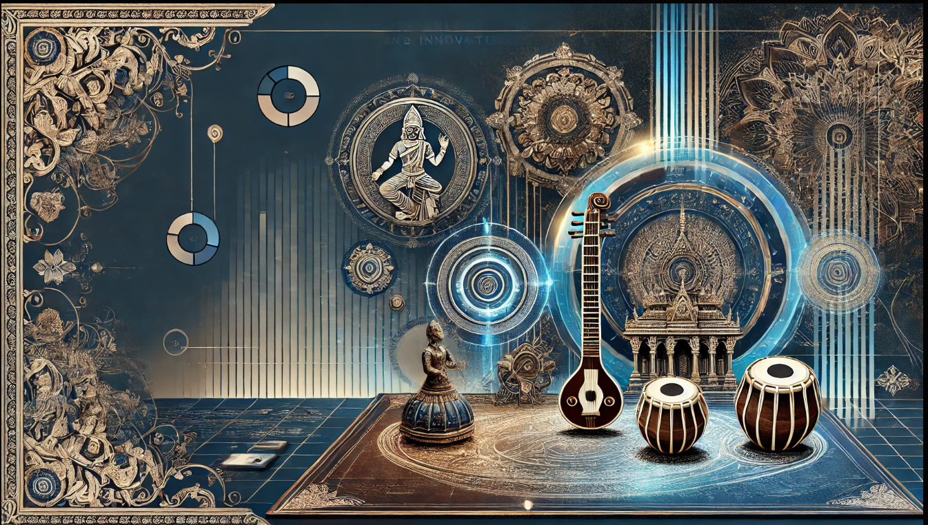







EDUCATIONAL INTEGRATION
Include Indian music and dance as part of global arts education
TECHNOLOGICAL PRESEVATION
Use AI to archive and analyze ancient compositions and techniques.
GLOBAL COLLABORATIONS
Promote partnerships between Indian and international artists for fusion projects.
PRESERVATION
INNOVATION
FUTURE
PROSPECTS
CONTEMPARY FUSION
Blend traditional forms with modern genres to create new styles and reach diverse audiences
DIGITAL PRESERVATION
YOUTH ENGAGEMENT
Expand access through virtual performances, online tutorials, and VR experiences
Inspire younger generations through gamified learning and social media trends

Slide 14
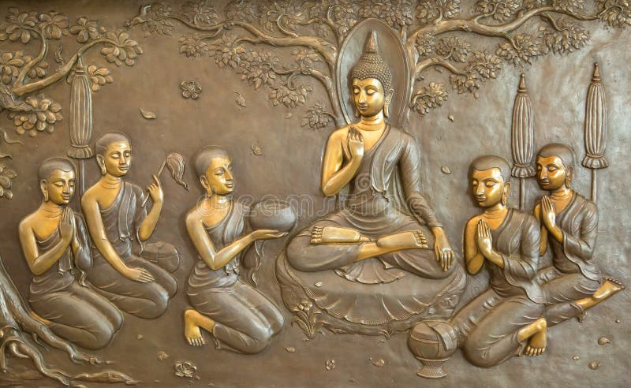


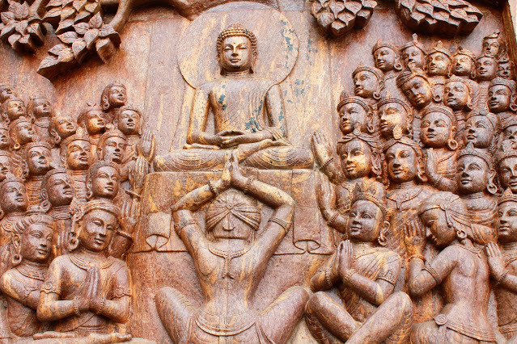
CONCLUSION
Indian music and dance symbolize timeless cultural heritage, connecting past and present. Support local artists, attend cultural events, and embrace these traditions to preserve and celebrate their enduring significance.

Slide 15
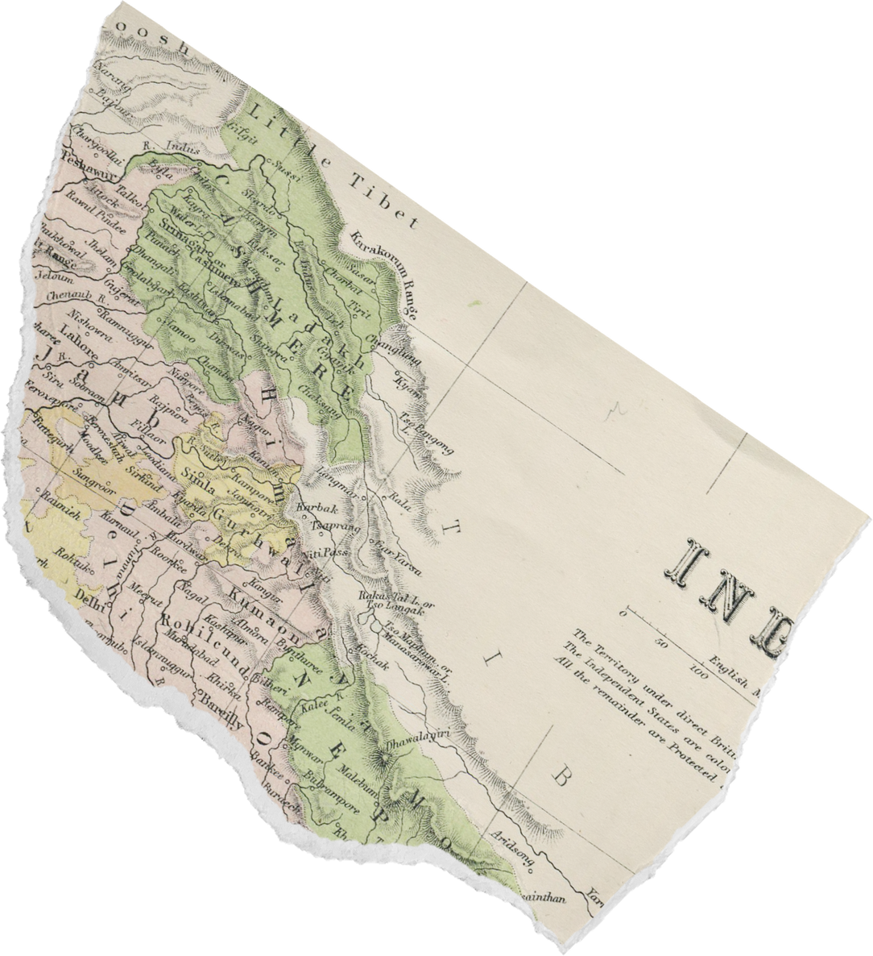
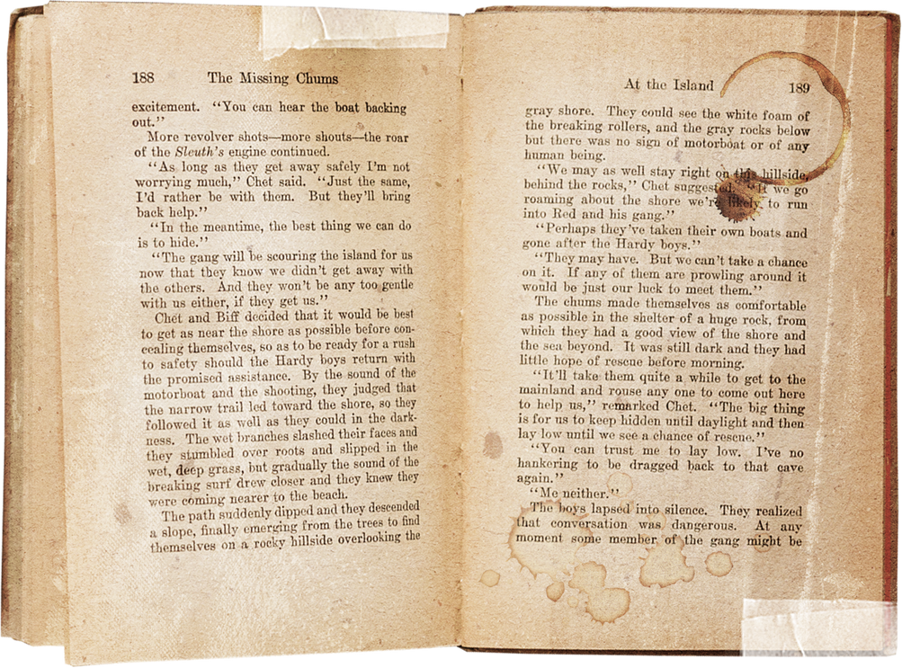
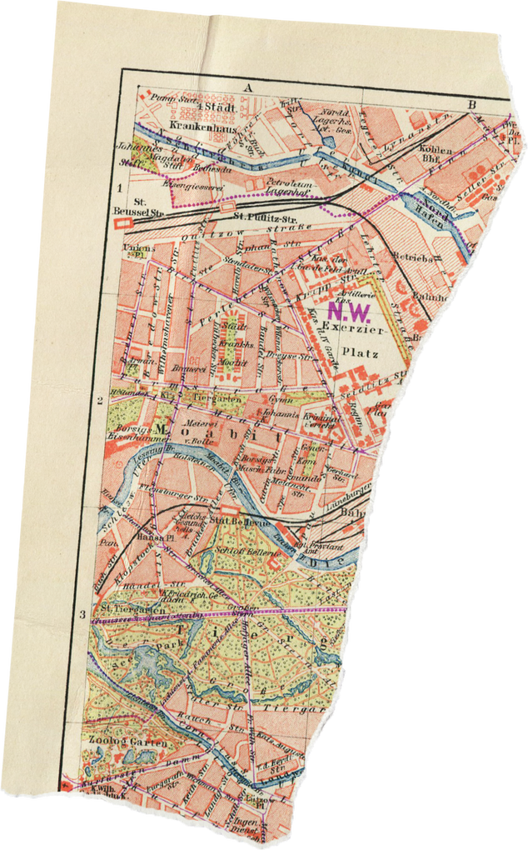

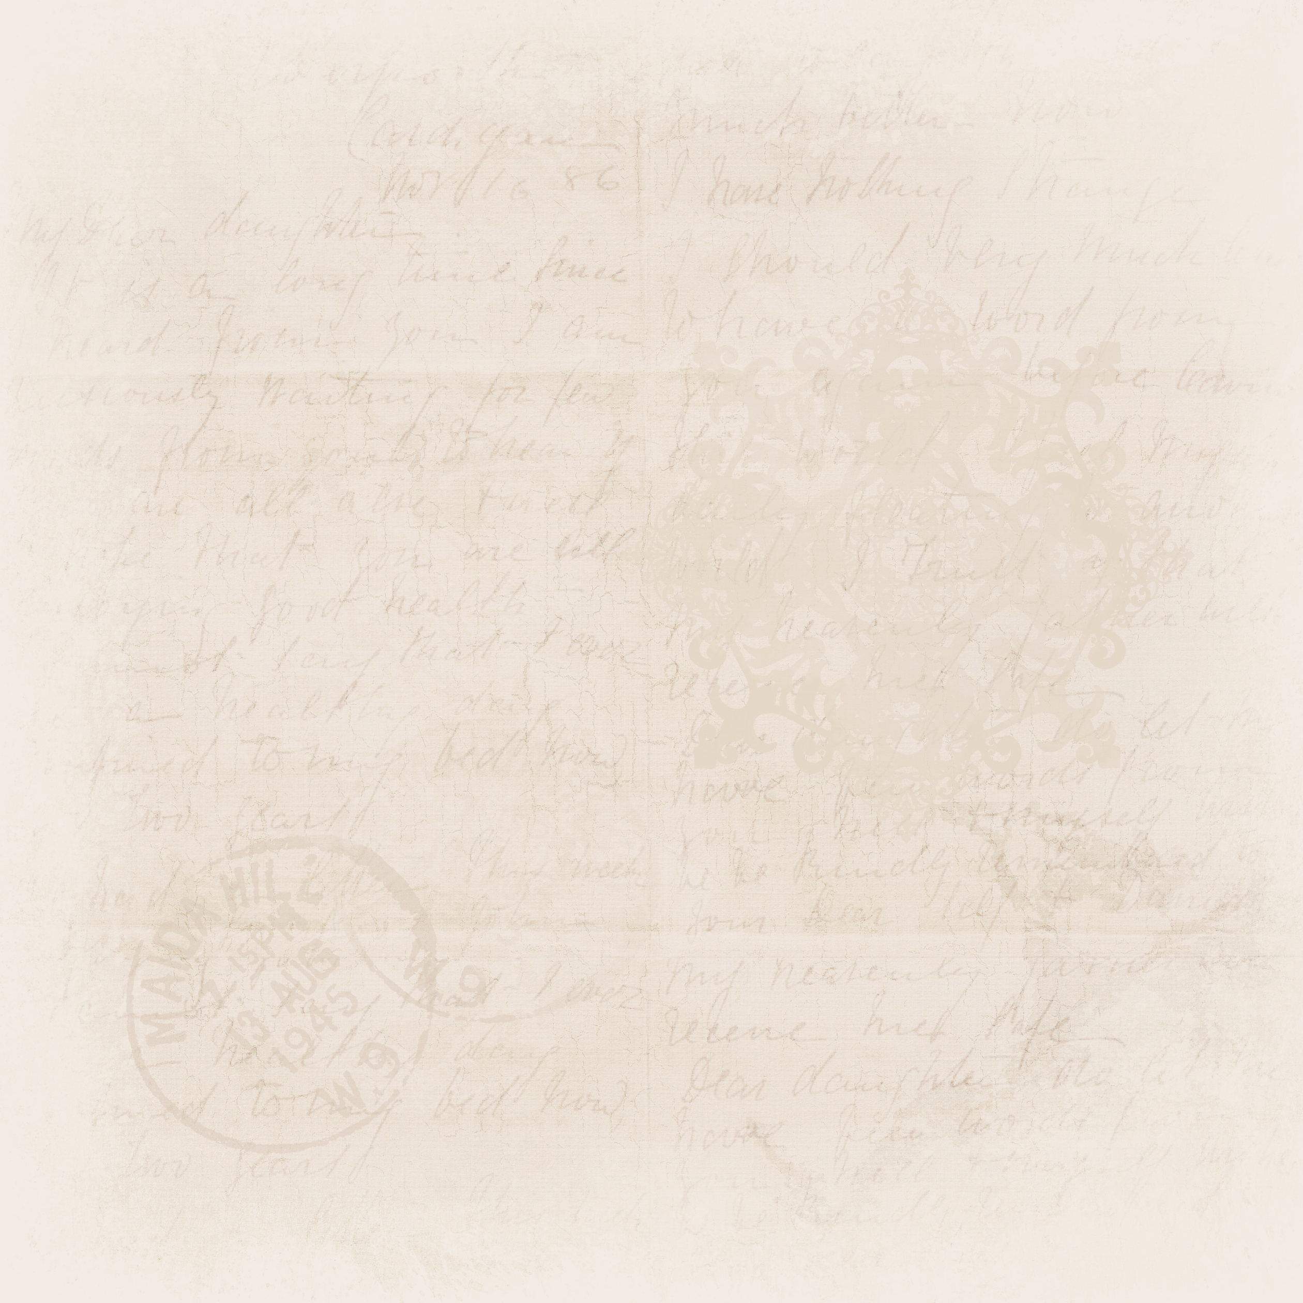

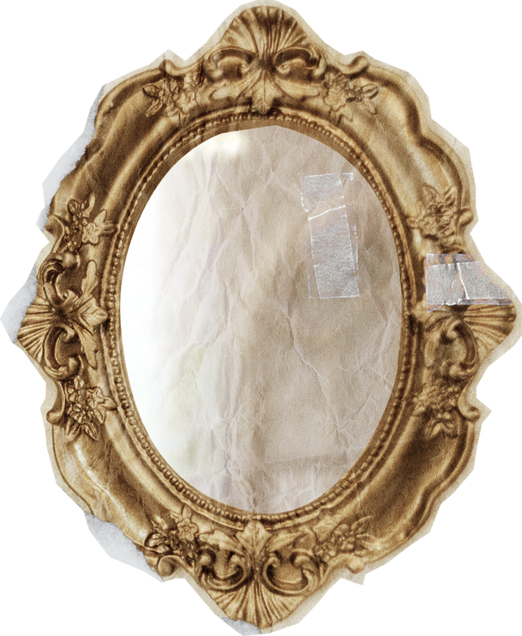

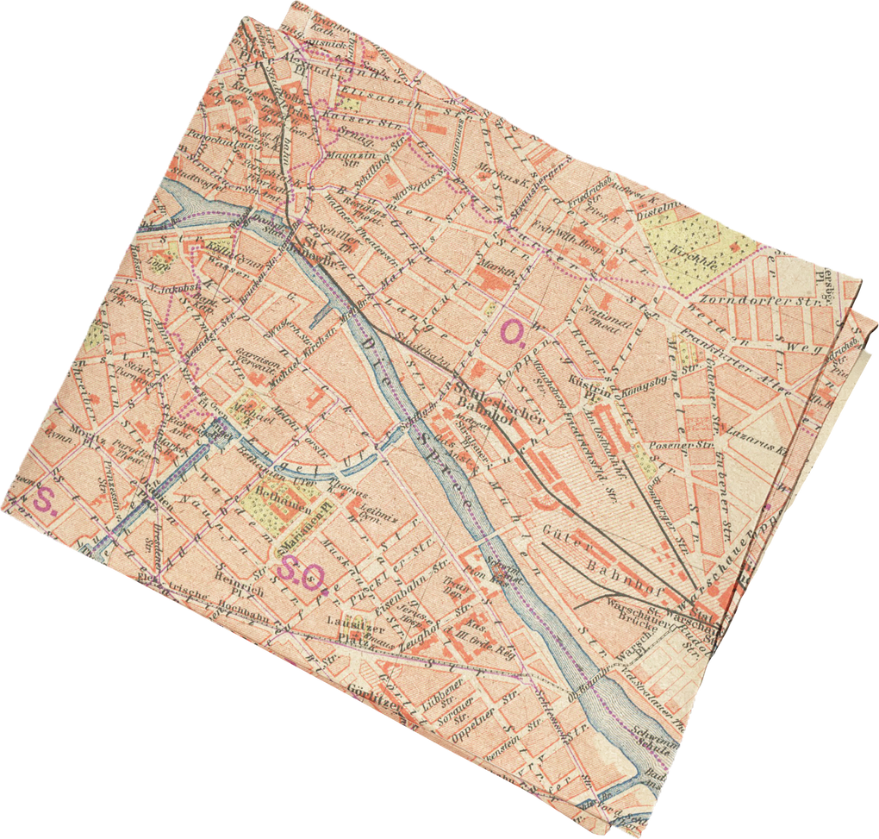
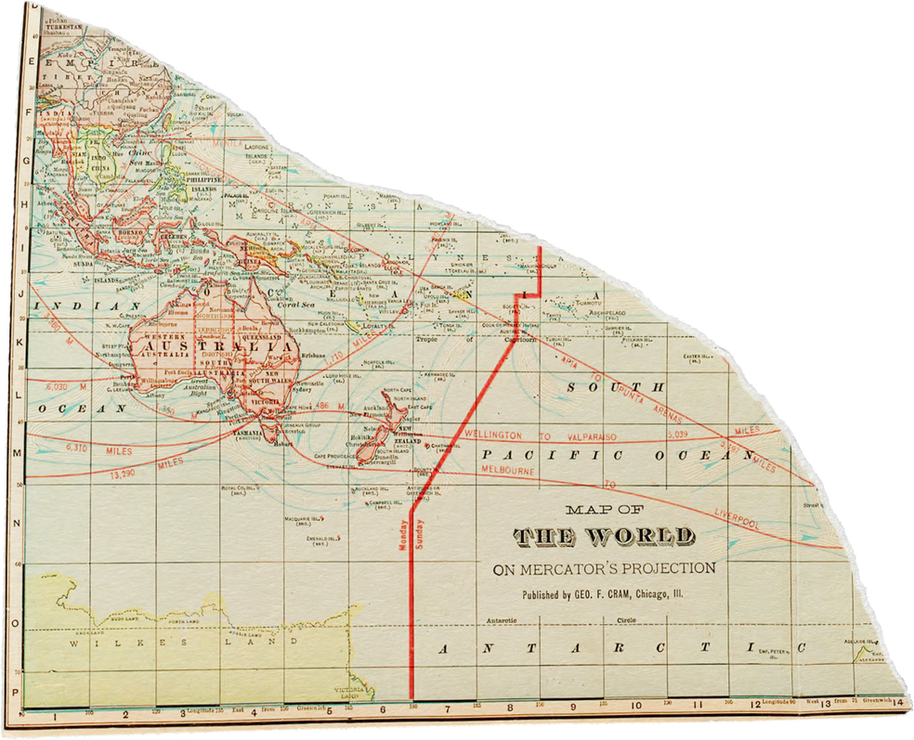
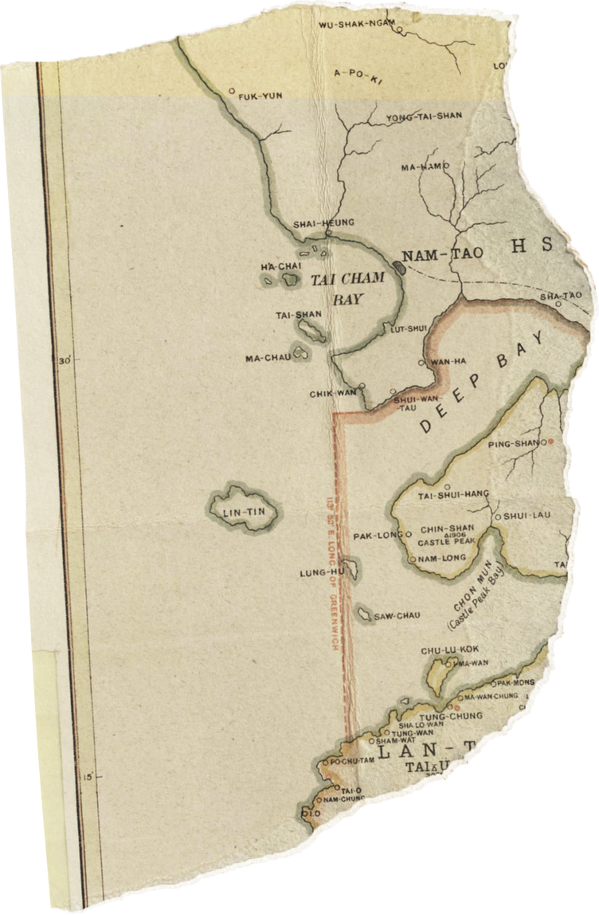
THANK YOU
Presented by Abhishek, Anjali, Darshan, Naina and Vraj
Group Leader – Darshan Ved
Members – Abhishek, Anjali, Naina, Vraj
Presentation – Darshan Ved, Naina Singh, Anjali Sinha
Information and Research – Abhishek, Anjali, Darshan, Naina and Vraj
Pictures , Animations – Darshan Ved
Design – Darshan Ved, Anjali Sinha, Naina Singh
Thank You audience for listening to us
Thanks to all my group members who gave their best in the making of this project

